Slide 1
Symbolic Transfer in Games
in Deep Reinforcement Learning
Tutor: Ekaterina
Team Members: Taylor Qin, Junming Zhao, Wei Zhou

Slide 2
What is our research about?
To transfer between games with similar rules but different symbols.

Slide 3
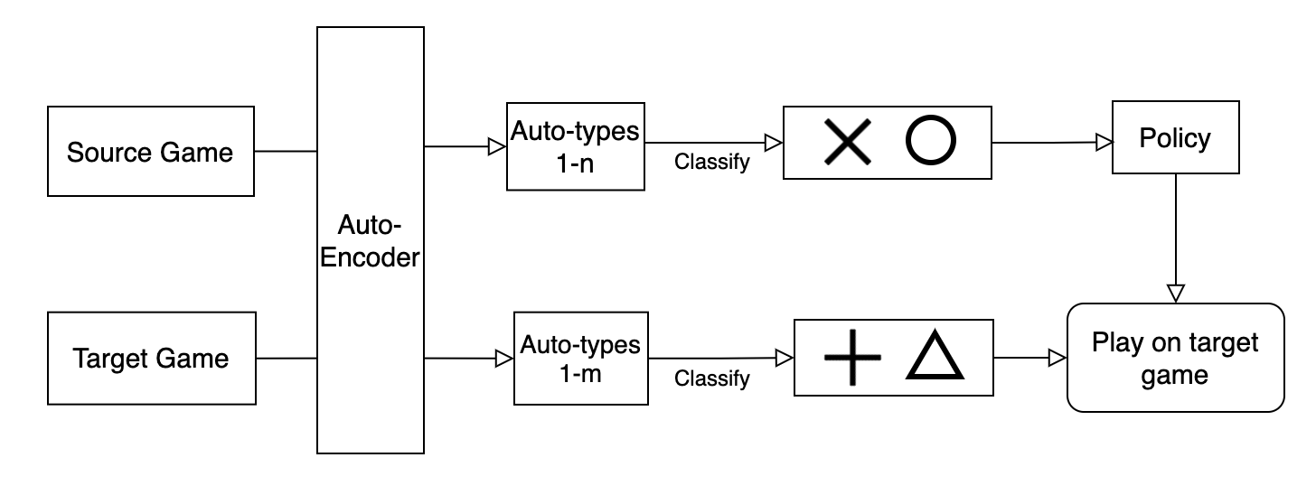
What methods do we use?
Unsupervised Symbol Extraction: Auto-Encoder
Classification: Probe Policy

Slide 4
Why is our research important?
Why transfer?
Save training time
Better performance of neural networks
Not needing a lot of data
Reuse prior knowledge
Why extract symbols?
Save more time
Complex symbols adaptable
Human-readable
Denoise

Slide 5
Our Results

Slide 6
Future work

